Slide 1
BioSCRAPE and BioCRNpyler
William Poole
DNA Super Group Meeting 1-28-19

Slide 2
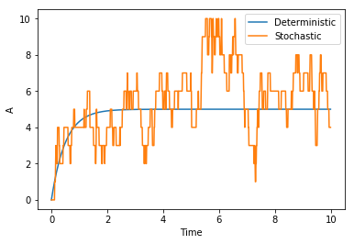
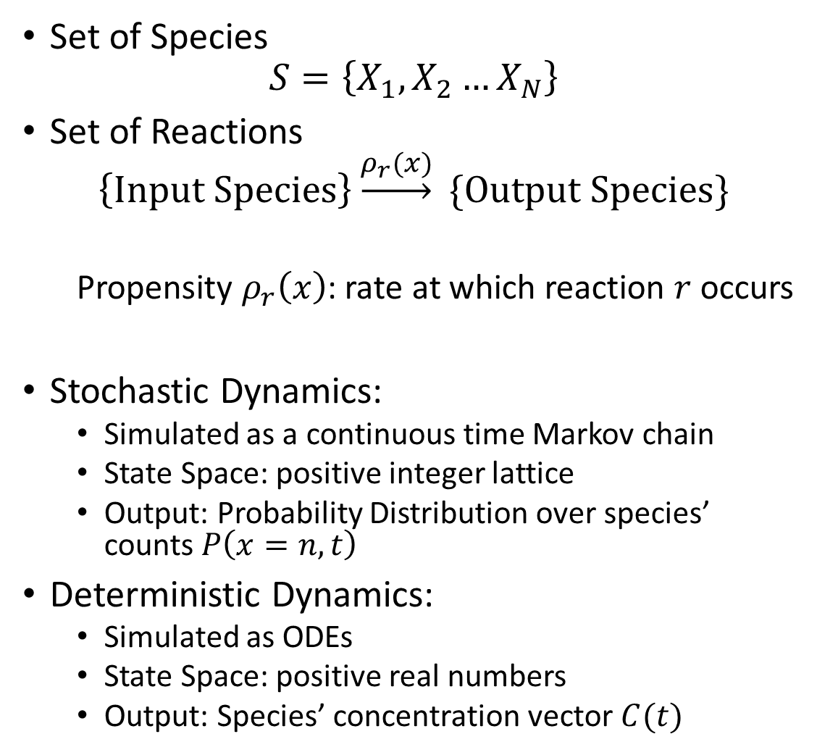
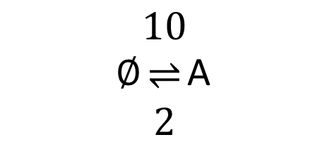
Background: Chemical Reaction Networks
Set of Species
$$S=\left\{X_{1}, X_{2}…X_{N}\right\}$$
Set of Reactions
$$\left\{Input Species\right\}\underset{→}{ρ_{r}(x)} \{Output Species\}$$
Propensity $ρ_{r}\left(x\right)$: rate at which reaction $r$ occurs
Stochastic Dynamics:
Simulated as a continuous time Markov chain
State Space: positive integer lattice
Output: Probability Distribution over species’ counts $P\left(x=n, t\right)$
Deterministic Dynamics:
Simulated as ODEs
State Space: positive real numbers
Output: Species’ concentration vector $C(t)$
$∅\begin{matrix}10 \\ ⇌ \\ 2\end{matrix}$A

Slide 3
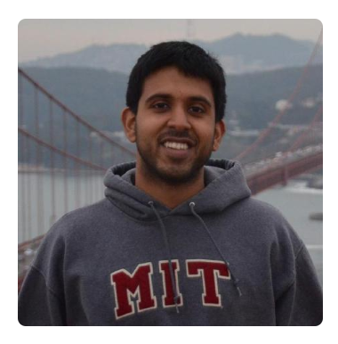
BioSCRAPE Overview
A fast general purpose chemical reaction network simulator
Written in Cython
C speeds with Python Compatibility
Support for:
Deterministic Simulation
Stochastic Simulation
Stochastic Simulation with Delay
Stochastic Cell Lineage Simulation (Cell Growth, Division, Death, and Partitioning)
SBML and BioSCRAPE XML to save models
Parameter inference via EMCEE
Code and Examples on Github
https://github.com/ananswam
Original BioSCRAPE Developer
Anandh Swaminathan

Slide 4
BioSCRAPE Overview
A fast general purpose chemical reaction network simulator
Object Oriented Framework, generalizable classes for:
Reaction Propensities
Massaction, hill functions, general functions
Parameter Update Rules
Cell Volume (Rules and Events)
Cell Division (Rules and Events including molecular partitioning)
Cell Death (Rules and Events)
Delay Reactions
Fixed, Gamma, and Gaussian distributed delays

Slide 5
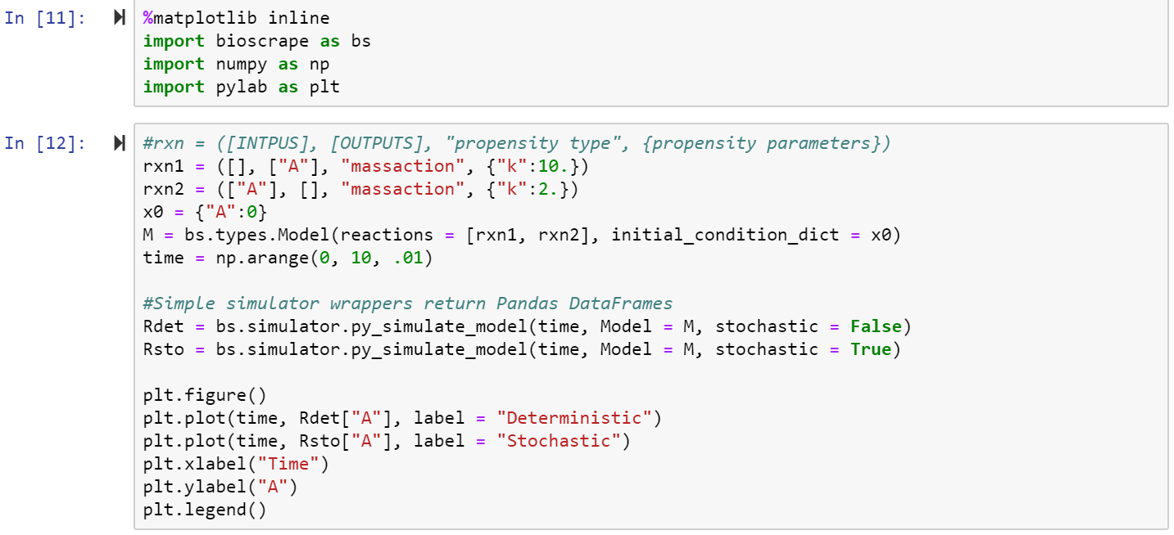

BioSCRAPE Example Code
$∅\begin{matrix}10 \\ ⇌ \\ 2\end{matrix}$A

Slide 6
BioSCRAPE Lineages
Key Features:
Simulates Ensembles of Growing, Dividing, Dying Cells
Events: occur stochastically due via propensities
Rules: occur deterministically
Customizable cell partitioning at division
Each Cell is its own CRN
Non-interacting cell lineages are parallelizable
Easy to use simulation wrappers
In Development:
Support of intercellular interactions via global species
Rigorous cell population down sampling

Slide 7
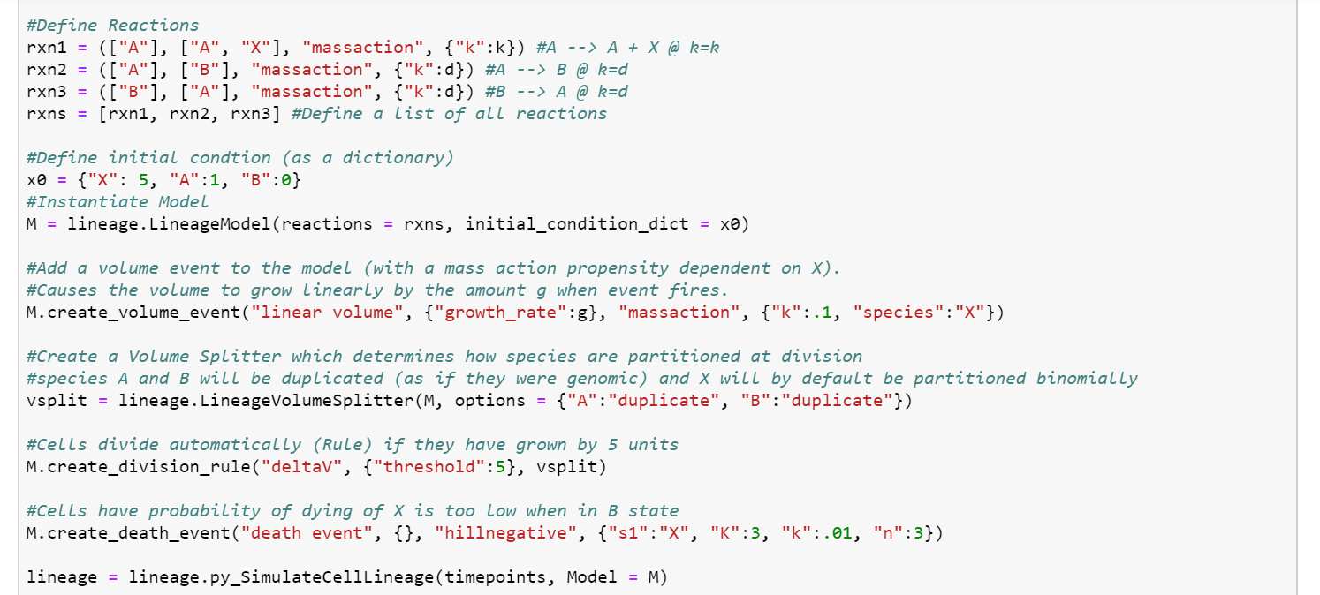

BioSCRAPE Lineages
Cellular CRN
$A\begin{matrix}d \\ ⇌ \\ d\end{matrix}B A\underset{→}{k}A+X$
Growth:
$V\underset{←}{k∗X}V+g$
Division occurs if $ΔV>5$
Death Occurs at the rate
$ρ_{death}\left(X\right)=\frac{k}{{\left(\frac{X}{K}\right)}^{n}+1}$

Slide 8
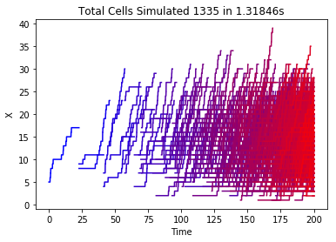
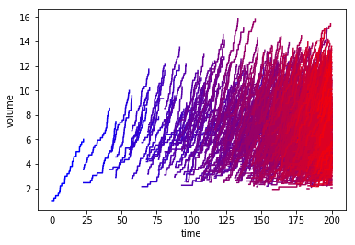
BioSCRAPE Lineages

Slide 9
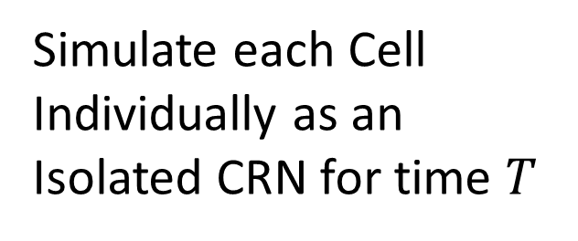
Support of intercellular interactions via global species
Simulate each Cell Individually as an Isolated CRN for time $T$
Synchronize global species (a subset of all CRN species) between all Cells
Technical Considerations:
Given a CRN, how long can T be?
Can a synchronization protocol be found so T is independent of the number of cells N?

Slide 10
Rigorous cell population down sampling
Simulate a Cell Lineage allowing cells to grow and divide and die
Downsample this cell lineage so the total cells are less N
Reconstruct Population Level Statistics from Downsampled Data
Technical Considerations:
How big must N be?
What is the right way to reconstruct population statistics?
Can global species be included in this procedure?
Can a form of rare-event (eg rare genetic mutations) sampling be included?

Slide 11
BioCRNpyler Project Overview
A Pythonic (Objected-Oriented and Modular) Version of TXTLsim (MATLAB)
Simple API to compile genetic circuits into chemical reaction networks (CRNs) (as a python object or SBML)
Modular mechanisms for modelling flexibility
Example Mechanisms: Transcription, Translation, Degradation
Support for common biological components
DNA Assemblies [Promoters, RBSs, etc]
Transcription Factor Activation/Repression
Integrases
RNA-Circuitry
Components added together to form a mixture
Joint work with Ayush Pandy (Caltech) and Zoltan Tuza (Imperial College London)

Slide 12
Object Oriented Architecture
Mixture
Default Mechanisms
Default Components
Components
Component-specific Mechanism “types” inherited from mixture or user-overwritten
Parameters: inherited from the mixture or user-overwritten
Mechanisms
Reaction schemas called by components
Default Parameters
Parameters inherited from components

Slide 13
Object Oriented Architecture: Example
Cell Extract
Mechanisms:
•Transcription
•Translation
•mRNA Degradation
Components
•Ribosomes
•Polymerases
•RNAases
PLac-GFP Assembly
Inherits: Translation, mRNA Degradation
Overwrites: Transcription with Repressed Transcription
Inherits: $k_{tx}$, $k_{tl}$, $δ_{RNA}$
Loads: Promoter and RBS Binding Constants
Inherits: 𝑘_𝑡𝑥, 𝑘_𝑡𝑙, 𝛿_𝑅𝑁𝐴
Loads: Promoter and RBS Binding Constants
Repressed Transcription
Input Species: Gene G, Repressor R, Transcript T
Input Parameters: binding rates, transcription rate
Outputs Reactions:
$$G+nR⇌G:R$$
$G+RNAP ⇌G:RNAP→G+T+RNAP$
Input Species: Gene G, Repressor R, Transcript T
Input Parameters: binding rates, transcription rate
Outputs Reactions:
𝐺+𝑛𝑅⇌𝐺:𝑅
𝐺+𝑅𝑁𝐴𝑃 ⇌𝐺:𝑅𝑁𝐴𝑃→𝐺+𝑇+𝑅𝑁𝐴𝑃
Parameters:
• Machinery Concentrations (e.g. [Ribosome], [RNAP])
• $k_{tx}$, $k_{tl}$, $δ_{RNA}$, etc.
Parameters:
• Machinery Concentrations (e.g. [Ribosome], [RNAP])
• 𝑘_𝑡𝑥, 𝑘_𝑡𝑙, 𝛿_𝑅𝑁𝐴, etc.

Slide 14
Mechanisms are Reaction Schemas
Black Box CRN
Inputs Species and Parameters
Outputs Species
User Specified
User Specified

Slide 15

Transcription Reaction Schema Examples
Stupidly Simple Transcription:
$$G→G+T$$
Gene G
Transcript T

Slide 16
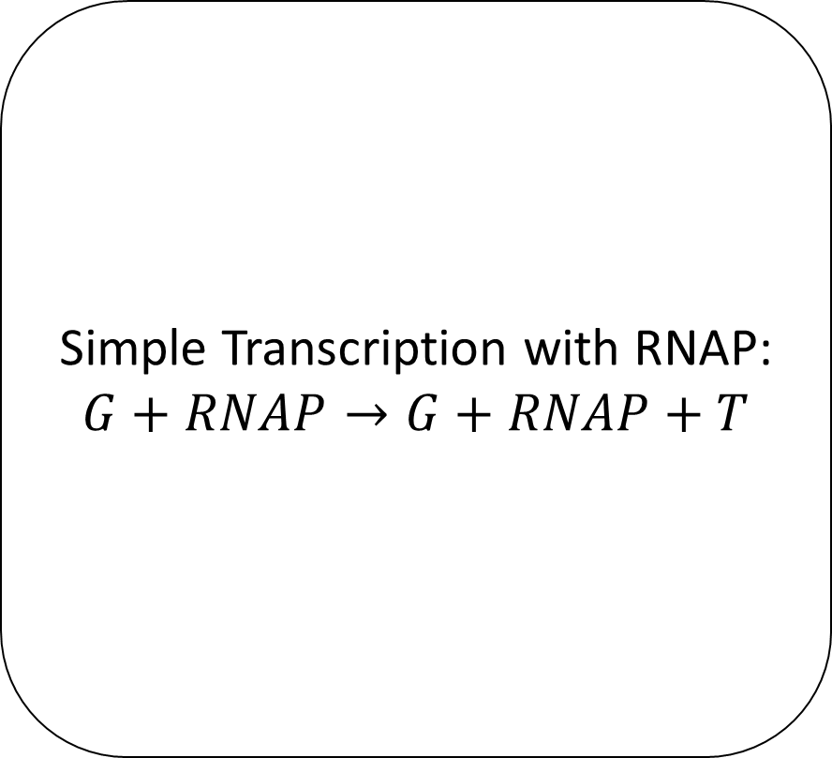
Transcription Reaction Schema Examples
Simple Transcription with RNAP:
$$G+RNAP→G+RNAP+T$$
Gene G
(Optional) RNAP Name
Transcript T

Slide 17
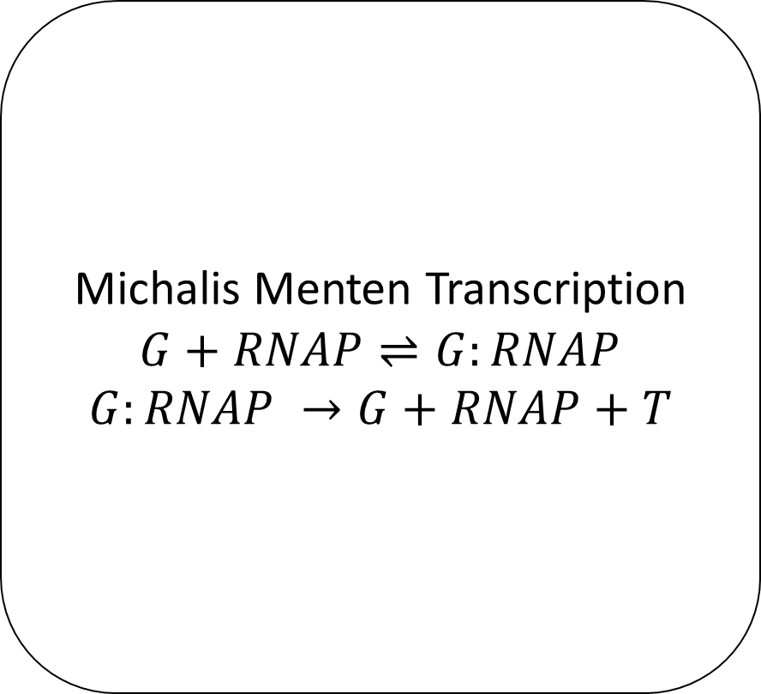
Transcription Reaction Schema Examples
Michalis Menten Transcription
$$G+RNAP⇌G:RNAP$$
$$G:RNAP →G+RNAP+T$$
Gene G
(Optional) RNAP Name
Transcript T

Slide 18
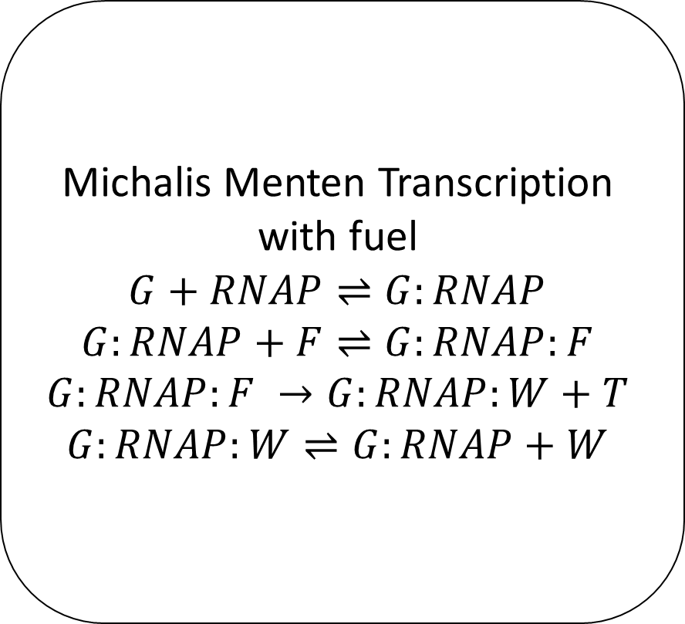
Transcription Reaction Schema Examples
Michalis Menten Transcription with fuel
$$G+RNAP⇌G:RNAP$$
$$G:RNAP+F⇌G:RNAP:F$$
$$G:RNAP:F →G:RNAP:W+T$$
$$G:RNAP:W⇌G:RNAP+W$$
Gene G
(Optional) RNAP Name, Fuel/Waste Names
Transcript T

Slide 19
Mechanism Inheritance
Component Subclasses know their mechanisms
e.g. a Promoter knows it needs ‘transcription’
Mechanism Hierarchy (Higher Takes Precedent)
Custom Component Mechanisms
Default Component Mechanisms
Custom Mixture Mechanisms
Default Mixture Mechanisms

Slide 20
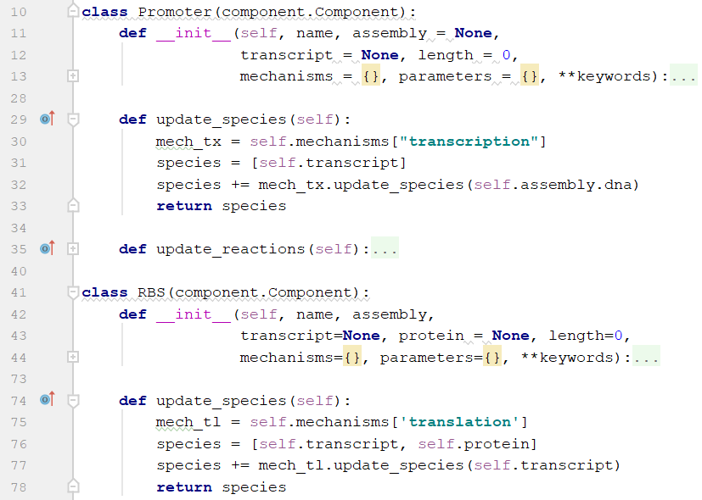
CRN Compilation
Mixture calls update_species() on each of its components.
Each component adds its species representation
eg a DNA construct will be represented by a species dna_[construct name]
Each component calls update_species() for each of its mechanisms
Custom method for each component in order to use reaction schemas
Each mechanism’s update_species() function returns all the species used in its internal CRN
Mixture checks to make sure there are no duplicate species

Slide 21
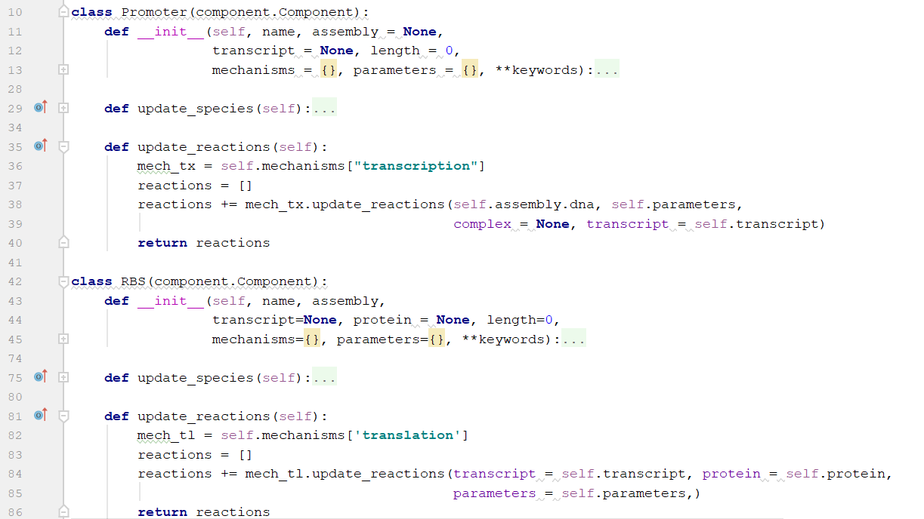
CRN Compilation
Mixture calls update_reactions() on each of its components.
Each component calls update_reactions() for each of its mechanisms
Components never create reactions
Each mechanism’s update_reactions() function returns all the chemical reactions used in its internal CRN
Custom method for each component in order to use reaction schemas
Mixture ensures that no reactions are duplicated

Slide 22
Parameter Structure
Inheritance:
Mixtures contain a parameter dictionary
Components default to parameters inherited from their mixture
Components’ custom parameter dictionary overrides the mixture dictionary
Data Sheets (In Development):
Components and Mixtures can load parameters from TSVs
Example: Different TSVs could represent different parts or different extract batches.
Multiple parts can be in a single TSV
Parameter values stored using identifiers: (mechanism, part id, param name) => Parameter Value
Unlocated identifiers default hierarchy
(mechanism, part id, param name) > (component, part id, param name) > (mechanism, param name) > (component, param name) … > (param name)

Slide 23
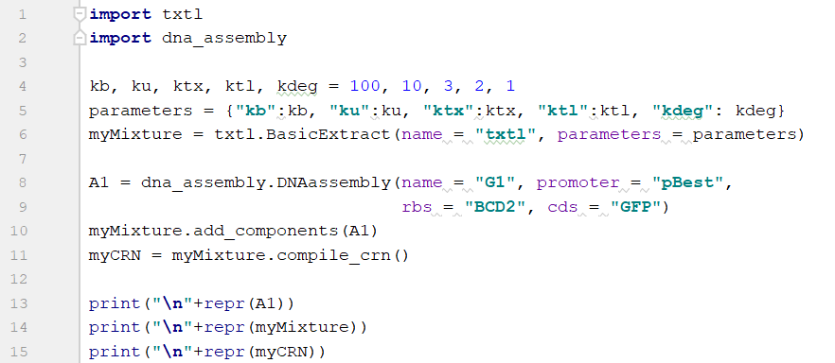
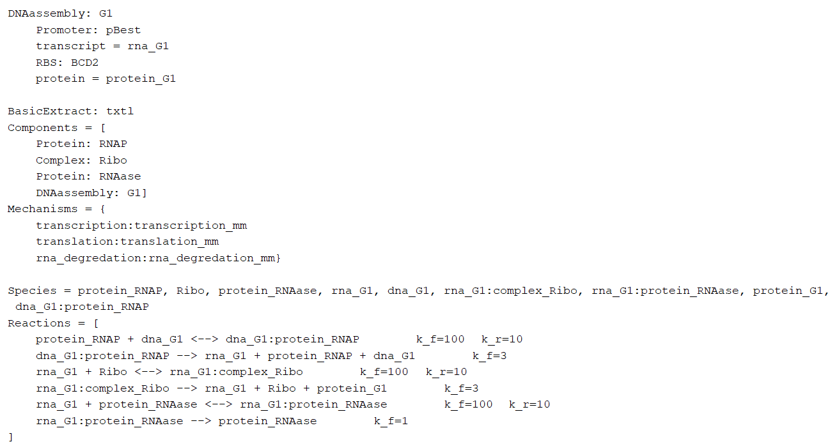
Constitutive Expression Demo

Slide 24

Retroactivity Demo: Background
Gene
mRNA
Protein
Resource Competition
Downregulates
Polymerase
Sigma Factors
Resource Competition
Upregulates
Resource Competition
Downregulates
Ribosomes
Endonucleases
Polymerase
Sigma Factors
$$∅$$
Ribosomes
Endonucleases
Gene
mRNA
Protein

Slide 25
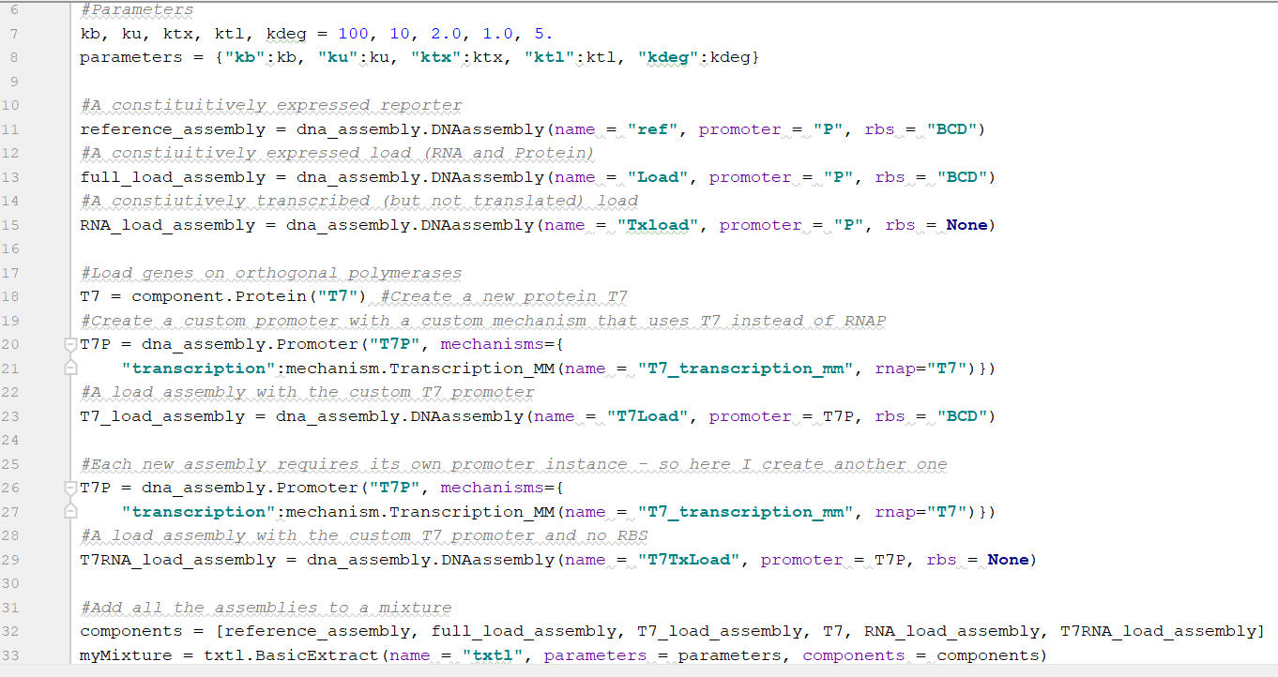
Retroactivity Demo
~15 lines of code without comments (including imports)

Slide 26
Retroactivity Demo
The CRN contains 30 Species and 26 Reactions
(reversible reactions counted just once)
Species = dna_ref, rna_ref:complex_Ribo, dna_ref:protein_RNAP, rna_ref:protein_RNAase, rna_ref, protein_ref, dna_Load, dna_Load:protein_RNAP, rna_Load, rna_Load:complex_Ribo, rna_Load:protein_RNAase, protein_Load, dna_T7Load, rna_T7Load:protein_RNAase, protein_T7Load, dna_T7Load:protein_T7, rna_T7Load:complex_Ribo, rna_T7Load, protein_T7, rna_Txload:protein_RNAase, dna_Txload:protein_RNAP, dna_Txload, rna_Txload, rna_T7TxLoad, dna_T7TxLoad:protein_T7, dna_T7TxLoad, rna_T7TxLoad:protein_RNAase, protein_RNAP, Ribo, protein_RNAase
Reactions = [
protein_RNAP + dna_ref <--> dna_ref:protein_RNAP k_f=100 k_r=10
dna_ref:protein_RNAP --> rna_ref + protein_RNAP + dna_ref k_f=2.0
rna_ref + Ribo <--> rna_ref:complex_Ribo k_f=100 k_r=10
rna_ref:complex_Ribo --> rna_ref + Ribo + protein_ref k_f=2.0
protein_RNAase + rna_ref <--> rna_ref:protein_RNAase k_f=100 k_r=10
rna_ref:protein_RNAase --> protein_RNAase k_f=5.0
dna_Load + protein_RNAP <--> dna_Load:protein_RNAP k_f=100 k_r=10
dna_Load:protein_RNAP --> dna_Load + protein_RNAP + rna_Load k_f=2.0
rna_Load + Ribo <--> rna_Load:complex_Ribo k_f=100 k_r=10
rna_Load:complex_Ribo --> rna_Load + protein_Load + Ribo k_f=2.0
rna_Load + protein_RNAase <--> rna_Load:protein_RNAase k_f=100 k_r=10
rna_Load:protein_RNAase --> protein_RNAase k_f=5.0
dna_T7Load + protein_T7 <--> dna_T7Load:protein_T7 k_f=100 k_r=10
dna_T7Load:protein_T7 --> dna_T7Load + protein_T7 + rna_T7Load k_f=2.0
Ribo + rna_T7Load <--> rna_T7Load:complex_Ribo k_f=100 k_r=10
rna_T7Load:complex_Ribo --> protein_T7Load + Ribo + rna_T7Load k_f=2.0
protein_RNAase + rna_T7Load <--> rna_T7Load:protein_RNAase k_f=100 k_r=10
rna_T7Load:protein_RNAase --> protein_RNAase k_f=5.0
protein_RNAP + dna_Txload <--> dna_Txload:protein_RNAP k_f=100 k_r=10
dna_Txload:protein_RNAP --> protein_RNAP + dna_Txload + rna_Txload k_f=2.0
protein_RNAase + rna_Txload <--> rna_Txload:protein_RNAase k_f=100 k_r=10
rna_Txload:protein_RNAase --> protein_RNAase k_f=5.0
protein_T7 + dna_T7TxLoad <--> dna_T7TxLoad:protein_T7 k_f=100 k_r=10
dna_T7TxLoad:protein_T7 --> rna_T7TxLoad + protein_T7 + dna_T7TxLoad k_f=2.0
rna_T7TxLoad + protein_RNAase <--> rna_T7TxLoad:protein_RNAase k_f=100 k_r=10
rna_T7TxLoad:protein_RNAase --> protein_RNAase k_f=5.0
]

Slide 27
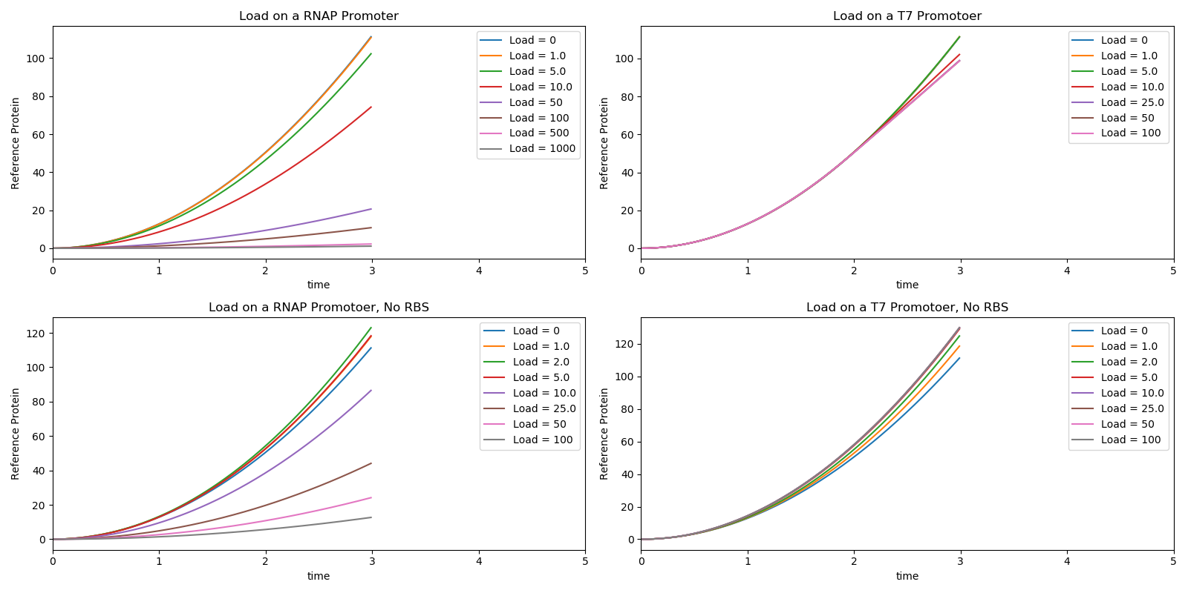
Retroactivity Demo
Stochastic simulations of each load assembly with the reference assembly
#ref_dna = 5, #polymerase = 10, #ribosomes = 100, #RNAase = 5

Slide 28
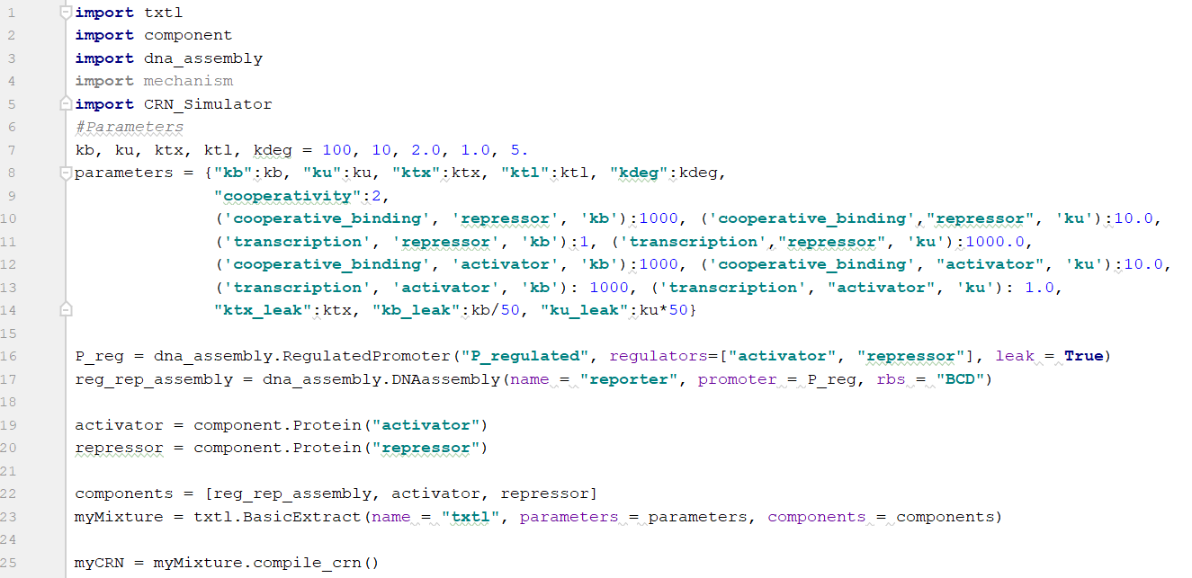
Activation/Repression Demo

Slide 29
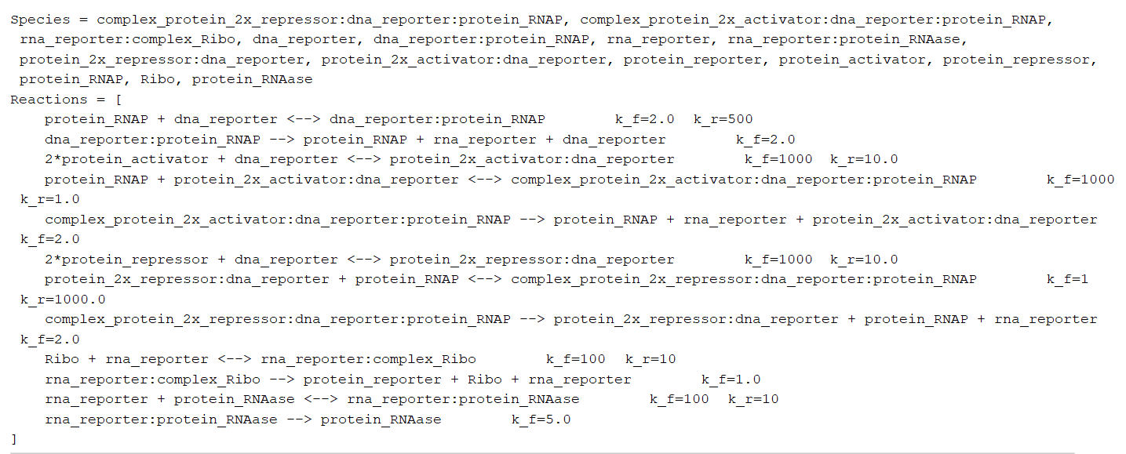
Activation/Repression Demo

Slide 30
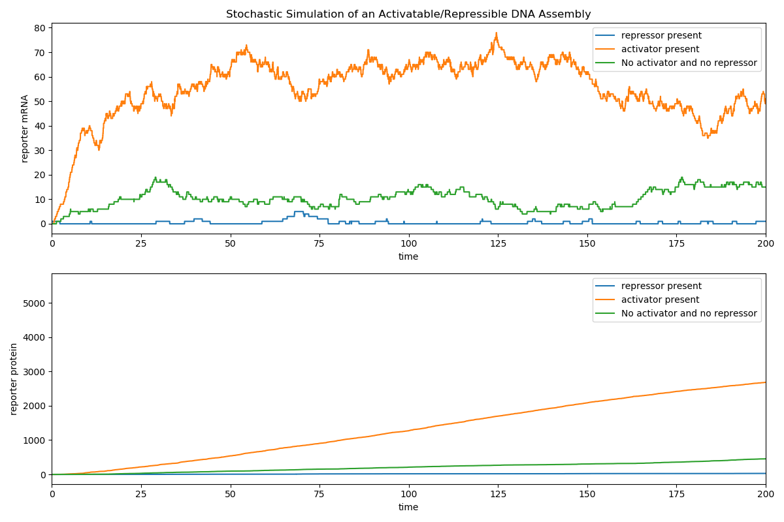
Activation/Repression Demo

Slide 31
Project Progress
Core Functionality
Core Class Structure
CRN Compilation
CRN Text Representation
CRN Graph Representation
Parameter Loading and Inheritance
Saving CRN to SBML
Rate Functions (as opposed to mass-action)
Documentation
Integration with BioSCRAPE
Add Mixtures Together
Comprehensive Test Cases
Core Component
DNA Assembly
Promoter
RBS
Generic DNA
Generic RNA
Generic Protein
Flippable Assemblies (via integrases)
Proteins with Degradation Tags
Proteins with Maturation Time
Regulated/Inducible Promoters
Combinatoric Promoters
(de)Cas9 and Guide RNAs
Core Mechanisms
Michalis-Menten Transcription (just RNAP)
Michalis-Menten Translation
Michalis-Menten RNA Degradation
Sigma Factor Transcription
Transcription with Fuel
Translation with Fuel
Linear DNA Degradation
GamS Protection
Transcription Factor Regulated Transcription (with/without Cross Talk)
Sense-Antisense RNA Regulated Transcription (with/without Cross Talk)
Integrases
(de)Cas9 DNA Binding
Protein Degradation (with and without fuel)

Slide 32
BioCRNpyler and BioSCRAPE for DNA Circuits
I’d love to help people use the software for other domains of CRNs
BioSCRAPE use cases:
Fast easy python simulation
Fast easy parameter inference from data
Simulation of experimental procedures using events and rules
BioSCRAPE.lineage use cases:
Simulation of multi-compartment systems
BioCRNpyler use cases:
Testing different levels of models (and model reductions) against each other
Managing large sets of CRN parameters
Enumerating Strand Displacement CRNs
Wrapper around Peppercorn perhaps?

